Slide 1
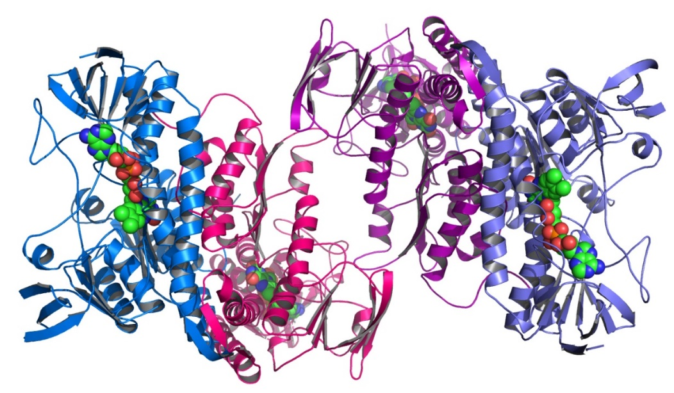
Chapter 4. Statistical modelling: Understanding Error (Variance) Structure
Terry Neeman, PhD AStat
Statistical Consulting Unit (SCU)
John Dedman Building, ANU

Slide 2
Key components of a statistical model of an experiment
Outcome measure
Response variable
Measure of interest
Experimental factors
Conditions that can be manipulated
Conditions of interest (e.g. genotype, gender)
Main questions: do the conditions impact upon the outcome measure?
Blocking factors – Data Structure
Conditions (not of interest) that may impact upon the outcome measure
Sources of variation in the experiment that need to be controlled for
Clustering of experimental units
ALWAYS BEGIN WITH A RESEARCH QUESTION

Slide 3
Statistical models: MEAN component & VARIANCE component
Mean structure
Depends upon Experimental Factors
VARIANCE component
Unrelated to Experimental Factors
Nuisance Factors
“Unexplained” noise

Slide 4
Describe the data structure in this experiment
How is seedling emergence (in Banksia) influenced by temperature and moisture?
low
high
high
low
low
high
high
low
low
high
high
low
Shed 1
Shed 2
Shed 3
Set up: 3 shelters, 4 garden beds per shelter, 24 pots per bed.
Experimental factors: 2 temperatures, 2 water levels

Slide 5
Key components of a statistical model of an experiment
Outcome measures
Plant height at week 3
Number of leaves at week 3
Experimental factors
Temperature (warm/ control)
Watering conditions (low/high)
Question: how does each factor affect outcome measures? Do the factors interact?
Blocking factors – Data Structure
Shed
“half-shed” within Shed
Garden bed within “half-shed”
Pot within garden bed

Slide 6
How to incorporate components of a statistical model into the model statement
Outcome measures
Plant height at week 3
Experimental factors
Temperature (warm/ control)
Watering conditions (low/high)
Blocking factors – Data Structure
Shed
“half-shed” within Shed
Garden bed within “half-shed”
Pot within garden bed
library(lmerTest)
lmer(height~Temp*Water + (1|Shed/half/bed)

Slide 7
IMPORTANT to include data structure in the model
Blocking factors can be a significant source of variation
Between-block variation can interfere with treatment comparison
Treatments comparison ---- within blocks
Separate out Between-block variation within-block variation

Slide 8
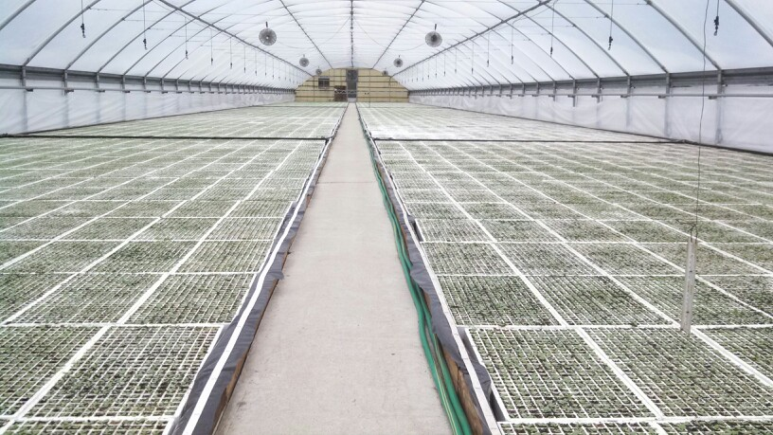
Example 1: Is photosynthetic rate affected by temperature?
24 plants grown in 3 different parts of the greenhouse
Outcome measure
Photosynthetic rate
Experimental factors
Temperature (high/low)
Blocking factors
Position (4)
2 parameter model (plus random effects)

Slide 9
Inference using linear model without and with blocking in R
model1=lm(PhotoRate~Temp, data=photosynthesis)
anova(model1)
Analysis of Variance Table
Response: PhotoRate
Df Sum Sq Mean Sq F value Pr(>F)
Temp 1 613.3 613.28 0.4386 0.5147
Residuals 22 30760.8 1398.22
model2=lmer(PhotoRate~Temp+(1|Position), data=photosynthesis)
anova(model2)
Sum Sq Mean Sq NumDF DenDF F.value Pr(>F)
Temp 613.28 613.28 1 19 4.521 0.04681 *

Slide 10
Treatment effect estimates without and with blocking in R
summary(model1) (No BLOCKING)
Coefficients: Estimate Std. Error t value Pr(>|t|)
(Intercept) 260.89 24.14 10.809 2.88e-10 ***
Temp 10.11 15.27 0.662 0.515
summary(model2) (with BLOCKING)
Random effects:
Groups Name Variance Std.Dev.
Week (Intercept) 1543.1 39.28
Residual 135.7 11.65
Number of obs: 24, groups: Week, 4
Fixed effects:
Estimate Std. Error df tvalue Pr(>|t|)
(Intercept) 260.887 21.031 3.820 12.405 0.000316 ***
Temp 10.110 4.755 19.000 2.126 0.046809 *

Slide 11
Data analysis
Organise data and import data
setwd(“ “)
photo<-read.csv(“Prac 4 photosynthesis.csv)
str(photo) #check data types in data set
photo$Position<-factor(photo$Position)
photo$Temp<-factor(photo$Temp)
2. Visualise the data
ggplot(photo,aes(Temp,PhotoRate,colour=Position))+
geom_point() + labs(x=“Temperature”)

Slide 12
Data analysis
Organise data and import data
2. Visualise the data
3. Model data and interpret output
library(lmerTest)
library(emmeans)
lmer1<-lmer(PhotoRate~Temp+(1|Position), data=photo)
anova(lmer1)
summary(lmer1)
emmeans(lmer1,~Temp)
4. Assess model assumptions
plot(lmer1)

Slide 13
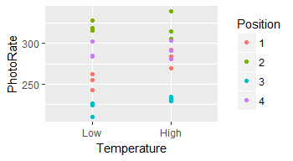
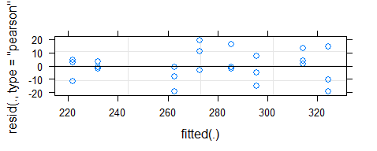

Model your data
Exploratory analysis
> lmer1<-lmer(PhotoRate~Temp+(1|Position), data=photosynthesis)
> anova(lmer1)
Sum Sq Mean Sq NDF DDF F.value Pr(>F)
Temp 613.28 613.28 1 19 4.521 0.04681 *
> summary(lmer1)
Random effects:
Groups Name Variance Std.Dev.
Position (Intercept) 1543.1 39.28
Residual 135.7 11.65
Number of obs: 24, groups: Position, 4
Fixed effects:
Estimate Std. Error df t value Pr(>|t|)
(Intercept) 270.997 19.927 3.087 13.599 0.000741 ***
TempHigh 10.110 4.755 19.000 2.126 0.046810 *
> emmeans(lmer1,pairwise~Temp)
$emmeans
Temp emmean SE df lower.CL upper.CL
Low 270.9973 19.92706 3.09 208.5815 333.4131
High 281.1074 19.92706 3.09 218.6916 343.5232
Assess model assumptions

Slide 14
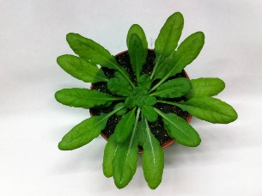
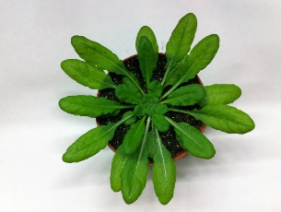
Example 2: Can a gene KO Arabidopsis modulate leaf temperature during drought?
Wild type controls
Normal conditions n = 2
Drought conditions n=2
Experimental mutant
Normal conditions n = 2
Drought conditions n=2
normal
Sample 4 leaves per plant
Sample 4 leaves per plant
drought

Slide 15
Example 2: Can a gene KO Arabidopsis modulate leaf temperature during drought?
Outcome measure
Leaf temperature
Experimental factors
Genotype (control/mutant) (2)
Watering conditions (2)
Blocking factors
Plant (4)
4 parameter model (plus random effects)

Slide 16
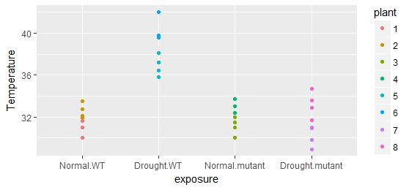
Visualising temperature data by treatment and Genotype
Outcome measure: Temperature
Experimental factors: Genotype (2), Watering conditions (2)
Blocking factor: Plant

Slide 17
Set up analysis for this experiment
drought <- read.csv(“Prac 4 drought data.csv”)
str(drought)
#Make Plant a Factor
drought$plant<- factor(drought$plant)
#Set Reference Levels
drought$Genotype<-relevel(drought$Genotype, ref=“WT”)
drought$WaterCondition<-relevel(drought$WaterCondition, ref=“Normal”)
#Visualise data
drought$cond<-with(drought,interaction(WaterCondition, Genotype))
ggplot(drought, aes(cond, Temperature,colour=plant))+geom_point()

Slide 18
Analysis of Variance without and with variance structure in R

Slide 19
Treatment effect estimates without and with variance structure
library(emmeans)
emmeans(lm.drought,~Genotype*WaterCondition)
Genotype Condition lsmean SE df lower.CL upper.CL
WT Normal 31.85 0.578 28 30.66 33.03
WT Drought 38.58 0.578 28 37.40 39.77
mutant Normal 32.07 0.578 28 30.89 33.25
mutant Drought 31.68 0.578 28 30.50 32.87
emmeans(lmer.drought,~Genotype*WaterCondition)
Genotype Condition lsmean SE df lower.CL upper.CL
WT Normal 31.85 1.29 4 28.25 35.44
WT Drought 38.58 1.29 4 34.98 42.18
mutant Normal 32.07 1.29 4 28.47 35.67
mutant Drought 31.68 1.29 4 28.08 35.28
Correct blocking structure is ESSENTIAL for correct inference!

Slide 20
Summary: Statistical Modelling
Identify Statistical Framework of Experiment
Outcome measures
Experimental Factors
Blocking Factors
Visualise your data/ look for patterns of interest
ggplot2
Experiment with simple models
Assess model fit
Draw conclusions

Slide 21
Chapter 5. Statistical modelling: Understanding Error (Variance) Structure II
Terry Neeman, PhD AStat
Statistical Consulting Unit (SCU)
John Dedman Building, ANU

Slide 22
Understanding Variance Structure
Error structure: impacts upon inference
Independent measurements: simple error structure
Blocking: between/within blocks
Treatment comparison: within blocks
Technical replicates: between/within biological samples
Treatment comparison: between biological samples
Statistical software chooses the correct variance component for comparison

Slide 23
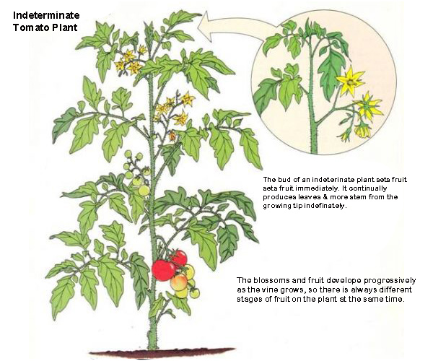
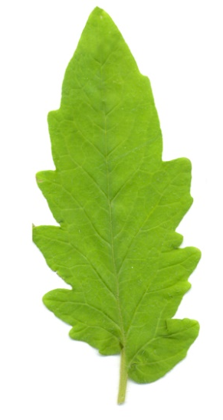
Understanding Variance Structure: Nested Structures
X 6 plants
X 3 leaves/plant
(1|plant) + (1|plant:leaf)
X 4 cores/leaf

Slide 24
Understanding Variance Structure:
Year 1 Year 2

Slide 25
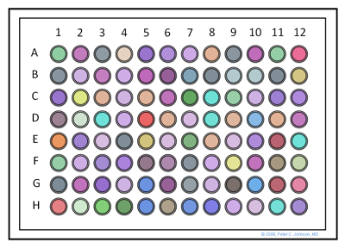
Understanding Variance Structure: Nested and Crossed Structures
(1|plate) + (1|row) + (1|column) OR
(1|plate) + (1|plate:row) + (1|plate:column)
What is the difference?

Slide 26
Getting the error term correct: a case study
Main research questions:
Does dark respiration vary within a leaf?
How does dark respiration vary by leaf age?
Does dark respiration vary across species?
Measurements:
9 plants- 3 plants/species (3 species)
3 leaf stages (ages): older - younger leaves
5 leaf sections from base to tip
n = 9x3x5 = 135 observations
Acknowledgements: Yuzhen Fan, honours student, Atkin lab (2017)

Slide 27
Set up analysis for this experiment
respire <- read.csv(“Prac 4 dark respiration.csv”)
str(respire)
#Make PlantID, Leaf_stage, Leaf_section Factor
respire$Plant_ID<- factor(respire$Plant_ID)
respire$Leaf_stage<- factor(respire$Leaf_stage)
respire$Leaf_section<- factor(respire$Leaf_section)
#Re-name Species factor
respire$Species<-factor(respire$Species, labels=c("PM","UP","ZM"))
#Visualise data
ggplot(respire, aes(Species, Dry_mass_resp,colour=Leaf_section))+geom_boxplot()
ggplot(respire, aes(Species, Dry_mass_resp,colour=Leaf_stage))+geom_boxplot()

Slide 28
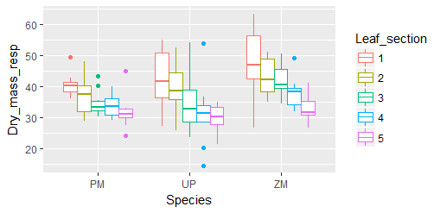
Data exploration: Respiration by Leaf Section

Slide 29
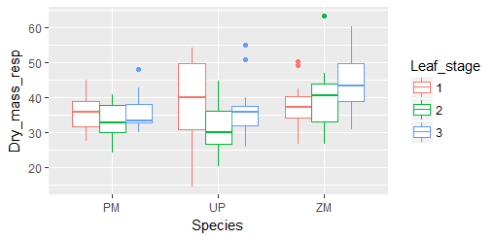
Data exploration: Respiration by Leaf Stage

Slide 30
What is the “correct error term” for: comparing between Species? comparing between Leaf stages? comparing between Leaf sections?
Comparing between plants (9 plants)
Comparing between leaves within plants (27)
Comparing between sections within a leaf (135)

Slide 31
Analysis of respiration experiment
model4<-lmer(Dry_mass_resp~Species*Leaf_stage*Leaf_section+(1|Plant_ID) + (1|Leaf_stage:Plant_ID),data=respire)
anova(model4)
Analysis of Variance Table of type III with Satterthwaite
approximation for degrees of freedom
Sum Sq Mean Sq NumDF DenDF F.value Pr(>F)
Species 192.32 96.16 2 6 2.7311 0.1434
Leaf_stage 163.75 81.88 2 12 2.3254 0.1401
Leaf_sec 2132.62 533.15 4 72 15.1424 4.9e-09
Sp:Leaf_stage 217.15 54.29 4 12 1.5419 0.2522
Sp:Leaf_sec 227.16 28.39 8 72 0.8065 0.5990
Leaf_stage:Leaf_sec 255.69 31.96 8 72 0.9078 0.5151
Sp:Leaf_stage:Leaf_s610.80 38.17 16 72 1.0842 0.3857

Slide 32
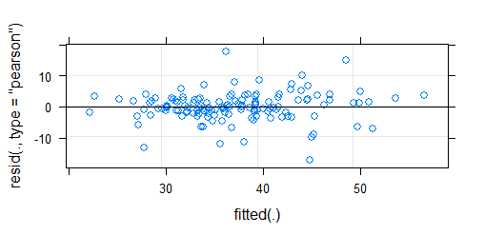
Sample analysis in R: Assessing Goodness of fit
plot(model4)

Slide 33
Key components of a statistical model of an experiment
Outcome measure
Response variable: continuous, binary(0/1), ordinal, count
Experimental factors
Conditions that can be manipulated
Conditions of interest (e.g. genotype, gender)
Main questions: do the conditions impact upon the outcome measure?
Blocking factors
Conditions (not of interest) that may impact upon the outcome measure
Sources of variation in the experiment that need to be controlled for
Clustering of experimental units
ALWAYS BEGIN WITH A RESEARCH QUESTION

Slide 34
Review: Statistical Modelling
Identify Statistical Framework of Experiment
Outcome measures
Experimental Factors
Blocking Factors
Visualise your data/ look for patterns of interest
ggplot2
Experiment with simple models
Assess model fit
Draw conclusions

